Slide 1
Why OCaml?
Notes:
About me
I'm going to explain to you why this is a thing we think is good
There will be code — I’m sorry about that. PLEASE ASK QUESTIONS!!!!

Slide 2
What are the requirements?
Correctness
Agility
Performance

Slide 3
Correctness
Notes:
Well obviously everyone cares…. Not actually
Facebooks motto was move fast and break things. For them forward progress was more important then not breaking the system
Would you bet your bank account on the correctness of your code?
On a busy day we trade 30 billion dollars. We don’t have 30 billion dollars.
there is no faster way to light yourself on fire then to do a stupid thing in a tight loop

Slide 4
Agility
Notes:
Things change fast:
New regulations
New venues
New products
New ideas
Many systems per developer
We deal with a lot of complexity - we trade 2% of US equity markets and in countries around the globe
but we only have about 150 developers
twitter has 2000 developers… for t witter

Slide 5
Performance
Notes:
3m msg/sec peek
500 - 700 m msgs/day
1000 of participants
millions of live orders
10k symbols
2.5 TB/day
Visa 150m txn/day, 24k peak txn/s
WhatsApp 20B msgs/day 250k txn/s avg, 350k tweets/sec peek
twitter 500m tweets/day 5k tweets/sec avg 150k tweets/sec peak

Slide 6
So Why OCaml?

Slide 7
Correctness

Slide 8
Algebraic Data Types
Records (Pair, Struct, Class)
Variants
Notes:
adt0.ml
Variants are really powerful for case analysis which comes up everywhere in code!!!

Slide 9
Algebraic Data Types
Case Analysis - Match statements
Make sure you’ve covered every case
Make sure you don’t have unused code
Make it easy to update the code later
Notes:
Example of Execution Order adt1.ml

Slide 10
Algebraic Data Types
Options: | Some of ‘a | None
Avoid many common types of runtime errors
Lookups in Tables
Opening a file
Parsing strings
Notes:
NO NULL PTR EXNS!!!

Slide 11
Agility

Slide 12
Agility
Problems with common languages used (Java, C++, VBA)
Verbose
Cut and paste code
Notes:
expr.ml vs Exp.java

Slide 13
Higher Order Functions
Make code easier to read and write
Avoid duplication
Share common code between projects
Highlight interesting differences in repeated blocks
Avoid duplication
Notes:
higher_order_functions.ml
z1.ml vs z2.ml

Slide 14
Performance
Notes:
perf.sh

Slide 15
Downsides

Slide 16
Downsides
Few other large users
(Notable exceptions: Facebook and Bloomberg)
NIH: Not by choice
Core, Async, Incremental, Rpc, Command
User Interfaces
Notes:
NIH: Not by choice Few libraries and tools that we can use that we haven’t written

Slide 17
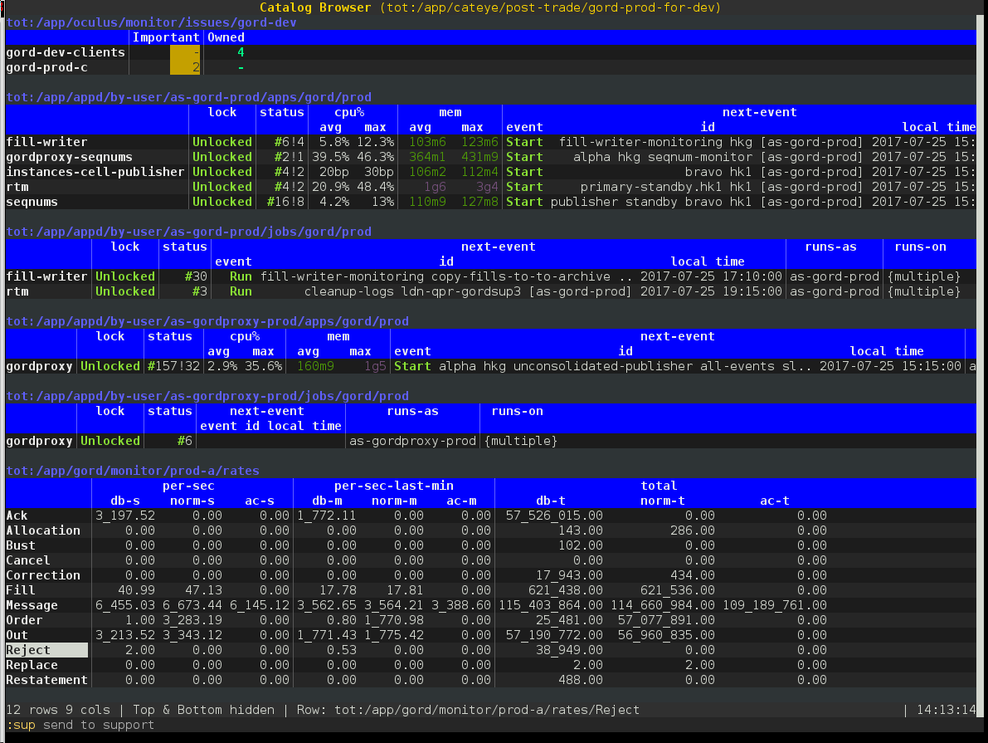

Slide 18
Downsides
Few other large users
(Notable exceptions: Facebook and Bloomberg)
NIH: Not by choice
Core, Async, Incremental, Rpc, Command
User Interfaces
No Common libraries for ui work
JS_of_OCaml

Slide 19
Why does any of this matter?

Slide 20
Why does this matter?
Different languages are different
They make different kinds of problems easier to solve
They change you
Notes:
CS is a useful tool no matter what field you go into
Learning to program teaches you to think carefully and precisely about the problems you want to solve
even though python doesn’t have a type system, my python ends up being more structured around types which makes it easier to read and easier to structure
The idea has validity outside of the bounds of OCaml

Slide 21
Questions?
Notes:
change this to js logo?

